Slide 1

Azure Service Fabric
Exploring Actor Models and Self-Healing Distributed Systems for Microservice Architectures
DX/TED
Steve Bohlen
Principal Software Engineer
& Technical Evangelist
sbohlen@gmail.com http://blog.unhandled-exceptions.com @sbohlen

Slide 2
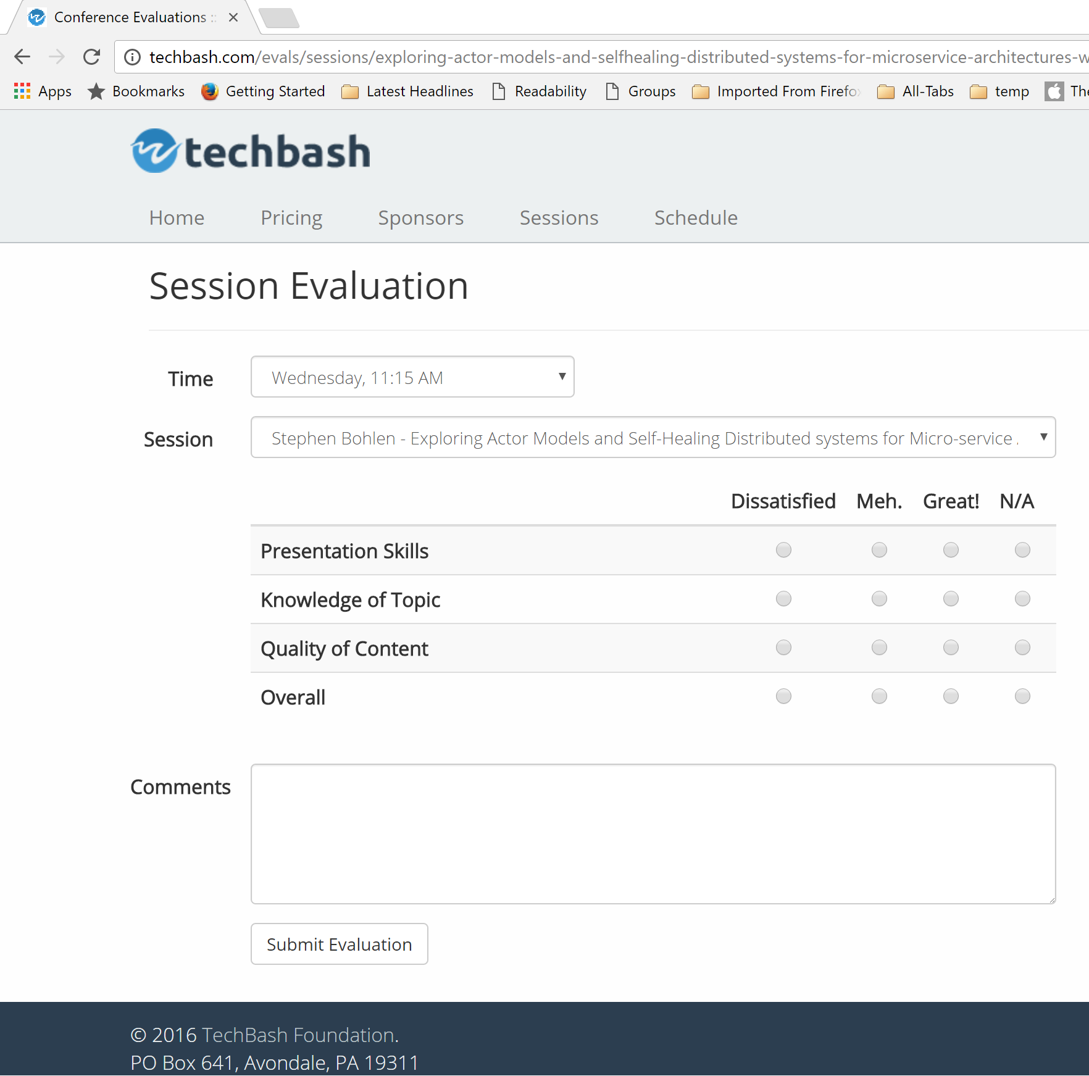




Please Complete the Evals!
http://techbash.com/schedule

Slide 3



Steve Bohlen
Over 25 years as a software developer
LISP, Delphi, C/C++, VB, VB.NET, Java, Ruby, C#, JavaScript
Principal Software Engineer, Microsoft
Co-Founder, NYC Alt.Net User Group
http://nyalt.net
Co-Organizer, NYC DDD User Group
http://dddnyc.org
Contributor: various OSS projects
NHibernate http://www.nhforge.org
Common.Logging http://net-commons.github.io/common-logging
NDbUnit http://www.googlecode.com/ndbunit
Spring.NET http://www.springframework.net
blog: http://blog.unhandled-exceptions.com
e-mail: sbohlen@gmail.com
twitter: @sbohlen
Membership: ASP Insiders, C# Insiders, Telerik Insiders, INETA Board of Directors
Alumni

Slide 4

I am a
employee…
…but these thoughts are my own!

Slide 5


Slide 6


Slide 7
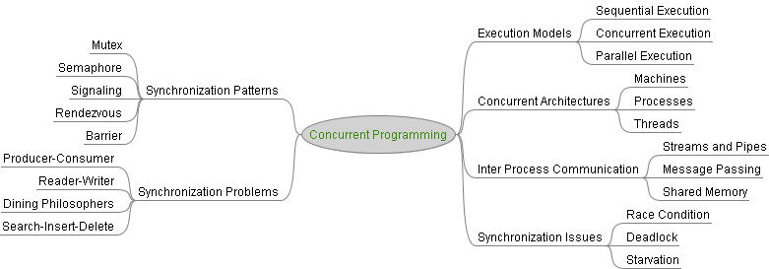
Concurrent and Parallel Programming is…
HARD
Complicated
Error-prone

Slide 8
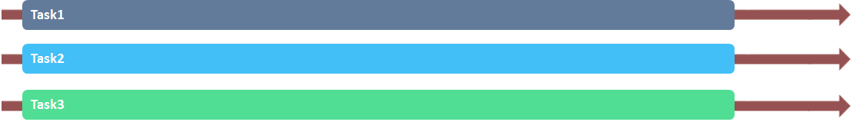
Concurrency vs. Parallelism
Concurrency
Parallelism

Slide 9
Fallacies of Distributed Computing
The network is reliable.
Latency is zero.
Bandwidth is infinite.
The network is secure.
Topology doesn't change.
There is one administrator.
Transport cost is zero.
The network is homogeneous.

Slide 10
Fallacies of Non-Distributed Computing
Memory is infinite.
Persistent storage is infinite.
All communication is successful.
Communication ordering is deterministic.
The runtime environment can be predetermined.
Application lifecycle is predictable and controllable.
etc., etc.

Slide 11


Slide 12


Slide 13





Actors to the Rescue!

Slide 14
Microservices

Slide 15
Typical Aspects of Microservices
Encapsulates a scenario
Are developed by a small engineering team
Can be written in any language and framework
Contain code plus state that is independently versioned, deployed, and scaled
Interact with other Microservices over well defined interfaces/contracts and protocols
Have a unique name (e.g., URL) that can be resolved
Remains consistent and available in the presence of failures
Notes:
Microservices applications are composed of small, independently versioned and scalable services that communicate with each other over standard protocols with well-defined interfaces
.
You as a developer think about code and data
You think about how you are going to upgrade it independent of other microservices
It is code that is versioned and scaled independently, having n copies of the service
You need to know how to find its endpoint by name
Microservices are code and config hosted in containers - Container here is used in the broader sense of the word, may be processes, maybe in a Windows Job Object or may be a Windows or Linux container
Microservices is a great way of codifying this thinking

Slide 16


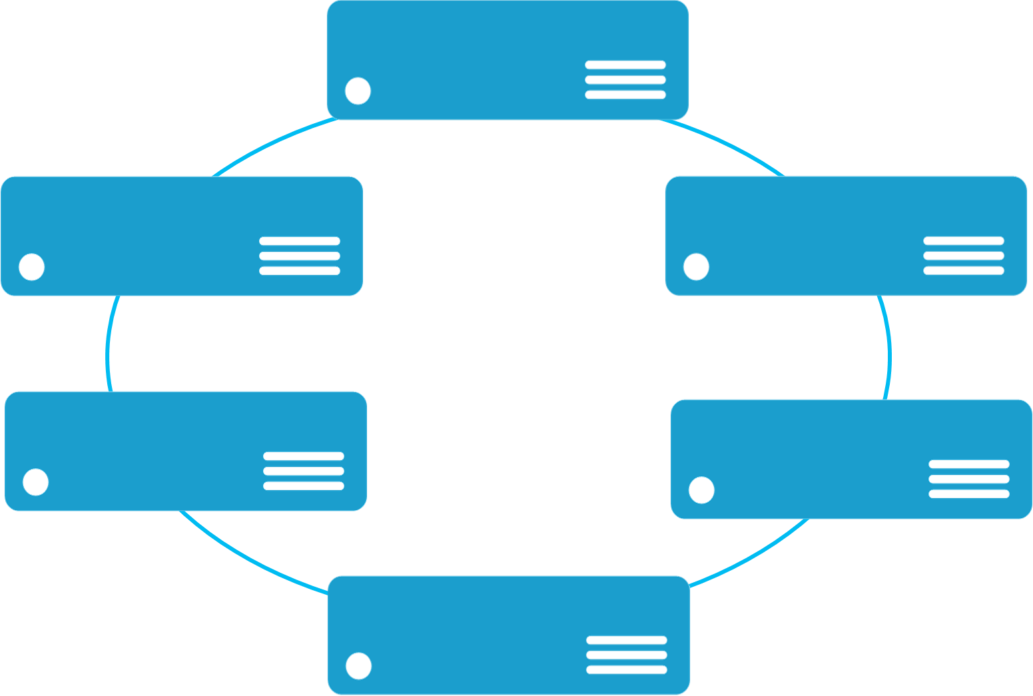


Monolithic application approach
Microservices application approach
A monolith app contains domain specific functionality and is normally divided by functional layers such as web, business and data
App 1
App 1
App 2
A microservice application separates functionality into separate smaller services.
Scales by cloning the app on multiple servers/VMs/Containers
Scales out by deploying each service independently creating instances of these services across servers/VMs/containers

Slide 17
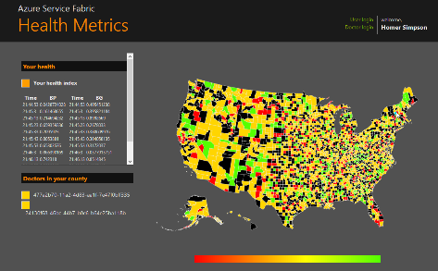
State in Monolithic approach
State in Microservices approach
Single monolithic database
Tiers of specific technologies
Graph of interconnected microservices
State typically scoped to the microservice
Variety of technologies used
stateless presentation services
stateless services
stateful services
stateless services with
separate stores

Slide 18
Azure Service Fabric

Slide 19
Azure Service Fabric
Lifecycle
Mgmt
Independent Scaling
Independent Updates
Always On Availability
Resource Balancing
Stateless/
Stateful
Azure Cloud
On Premises
Private cloud
Other Clouds

Slide 20
Service Fabric State of the Union
Azure Service GA-ed at //build/ in March 2016
Service upgraded every month
Release new features, developer SDK in a dot release every 8 weeks
GA for the standalone release for Windows Server 2012 R2 and Windows 2016 (including Nanoserver) coming soon
Included in Azure Stack GA
Linux limited preview available today and updated once a month. Linux public preview to follow!
https://channel9.msdn.com/Blogs/Windows-Azure/Service-Fabric-Linux-Preview

Slide 21
Intune
800k devices
Built with Service Fabric
Azure Core Infrastructure
thousands of machines
Skype for Business
Hybrid Ops
IoT Suite
Azure Document DB
billions transactions/week
Azure SQL Database
1.4 million databases
Event Hubs
20bn events/day
Bing Cortana
500m evals/sec
Power BI

Slide 22
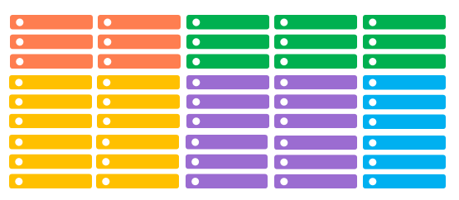
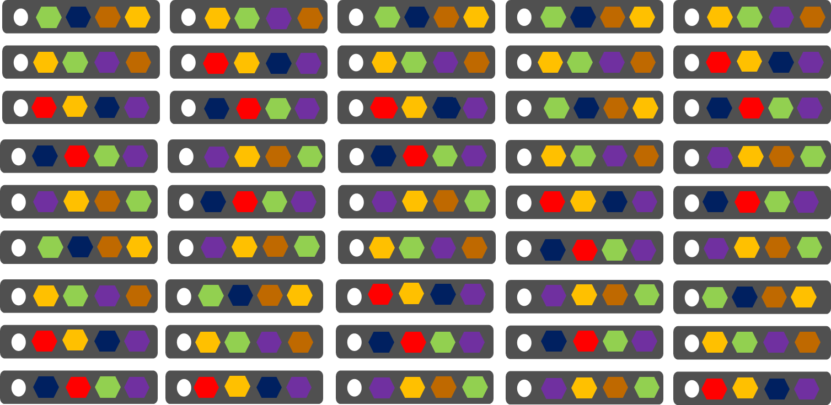
Comparing Azure Cloud Services vs. Azure Service Fabric
Azure Cloud Services
(Web and Worker Roles)
Azure Service Fabric
(Stateless, stateful or Actor services)
1 service instance per VM with uneven workloads
Lower compute density
Slow in deployment & upgrades
Slower in scaling and disaster recovery
Many microservices per VM
High microservices density
Fast deployment & upgrades
Fast scaling microservices across the cluster

Slide 23
Service Fabric Infrastructure

Slide 24
Concepts
Cluster
A network-connected set of virtual and/or physical machines
Microservices are deployed and managed in one or more clusters
Scales to thousands of nodes
VM Scalesets when running Service Fabric in Microsoft Azure
Node
A physical machine or virtual machine that is a member of a cluster
Physical/virtual machines may be homogenous or heterogeneous

Slide 25
6-Node Service Fabric cluster with Microservices
App1
App2
Notes:
There are two important concepts to understand with Service Fabric
First you create a pool of machines called a Service Fabric cluster. This can start as small as 3 machines and grow to thousands of machines. It is fully elastic, and with no single point of failure.
This cluster of physical or virtual machines can be heterogeneous, some small, some large as well. In Azure the clusters can be deployed across availability sets and across regions for redundancy. These are VMs that you own, joined by a VNET and stitched together to form a scalable cluster.
Second you build applications that are composed of discrete microservices by writing code. Then you simply tell Service Fabric through a declarative model to deploy these service across the cluster Service Fabric determines the best place to insatiate and run them, based on the available machine resources. You can create multiple copies of the same application instance and you can reuse microservice across difference applications.
This is application and service orchestration achieving unparalleled levels of density and control at the APPLICATION level. The services are placed into containers, processes today and Windows Containers when they are available for resource and security isolation. Note; this is not simply about moving containers around, this is understand how to manage the microservices within those containers which is actually the code you as a developer write.

Slide 26
Handling machine (node) failures
App1
App2
Notes:
Importantly Service Fabric orchestration of the services is transparent to you in the event of failures.
For example if a machine fails then all the services that were running on that machine are automatically redistuted acorss the cluster, based on the available machine resources as well as understanding the resource usage of the microservices. This is critical for example for running SQL Azure DBs where you have some very large databases and many smaller ones. Getting the best package density enables you to run the service efficiently at scale, something no human could realistically achieve.

Slide 27
Service Fabric Application Building Blocks

Slide 28
Types of Services in Service Fabric
Reliable Actors
An independent unit of compute and state
Communicates using asynchronous messaging
Single threaded execution (turn based concurrency)
Reliable Services API
Stateless Service
Either no state or state persisted independent of Service Fabric
There can be n instances (scale-out)
e.g. web frontends, protocol gateways, Azure Cloud Services etc.
Stateful Service
Maintain hard, authoritative state
n consistent copies achieved through replication and local persistence
e.g. database, documents, workflow, user profile, shopping cart etc.
Guest Executables
Existing binary (.exe)
Packaged for deployment and management in Service Fabric

Slide 29






Stateless Services Pattern
Load Balancer
Scale stateless services backed by partitioned storage
Increase reliability and ordering with queues
Reduce read latency with caches
Manage your own transactions for state consistency
More moving parts each managed differently
Front End
(Stateless
Web)
Stateless
Middle-tier
Compute
Cache
Queues Storage
Notes:
<build slide>

Slide 30

Stateful Services Pattern Simplify design, reduce latency
Load Balancer
Application state lives in the compute tier
Low Latency reads and writes
Partitions are first class at the service layer for scale-out
Built in transactions
Fewer moving parts
External stores for exhaust and offline analytics
Front End
(Stateless
Web)
Stateful
Middle-tier
Compute
Cold Data Stores
For Exhaust
(Optional)
Notes:
<build slide>
All first party services are stateful

Slide 31
Reliable Collections
Reliable collections make it easy to build stateful services
An evolution of .NET collections for the cloud
Collections
Single machine
Single threaded
Concurrent
Collections
Single machine
Multi threaded
Reliable Collections
Multi machine
Replicated (HA)
Persistence (durable)
Asynchronous
Transactional

Slide 32


Reliable Collections
IReliableDictionary<TKey,TValue>
IReliableQueue<T>
Data is replicated and durably stored on multiple replicas
Atomically update one or more collections using transactions
Supports LINQ
Notes:
Data is replicated and durably stored on multiple replicas.
Atomically update one or more collections using transactions.
Reads are repeatable within the transaction.
Enumerations are snapshot based.
Supports LINQ.

Slide 33
DEMO: Your First Service Fabric Project

Slide 34
DEMO: Exploring Stateful and Stateless Services

Slide 35
Reliable Actors

Slide 36
Reliable Actors API
Build reliable stateless and stateful micro-services with a virtual Actor Programming Model
Harness the full power of the Service Fabric platform
Reliable replicated state storage, failover, placement, resource balancing, zero downtime upgrade, tooling, security, diagnostics
Suitable for applications with multiple independent units of state and compute
Notes:
The reliable actor APIs allows you to harness the full power of Service Fabric functionality a simplistic virtual Actor based programming model. It is suitable for applications with multiple independent units of state and compute such as games or IoT.

Slide 37
Virtual Actors: Not your Father’s ActorSystem
Common ActorSystem Concepts (Erlang, Akka/Akka.NET)
Parent, Child, Sibling relationships between actors
Hierarchical dependency graph of actors
Supervisory Patterns govern parent-child recovery from failures
Actor Mailboxes (message queues, transactional dequeue)
Virtual ActorSystem (pioneered by MSR in e.g., Project Orleans)
Actors are (automatically) constructed/destructed behind the scenes in response to changes in workloads and resources
Code that calls on the actor remains unaware of this behavior

Slide 38
Direct Actor-to-Actor Communication
Actor1
Actor2
Transport Protocol
Actor1
Actor2

Slide 39
Introducing ActorProxy
Actor1
Actor2
Actor2
Proxy
Transport Protocol
Actor1
Actor2
Actor2
Proxy

Slide 40
ActorProxy
Provides a location-aware location-independent abstraction around an Actor
The only mechanism to communicate with an Actor
The only legal ‘reference’ to an Actor
Provides a transport-aware mechanism for sending messages to an Actor
Updated by the ActorSystem in response to Actor lifecycle events (e.g., restart in response to errors)

Slide 41
Actors in Action: FizzBuzz

Slide 42
Refresher: the FizzBuzz Problem Statement
Given a range of numbers, for each number n in the range:
If n is evenly divisible by 3, return ‘Fizz’
If n is evenly divisible by 5, return ‘Buzz’
If n is evenly divisible by both 3 and 5, return ‘FizzBuzz’
If none of the above are true, return ‘n’

Slide 43
FizzBuzz System Communication Flow
Service Fabric
n parallel workers
Eval
REST Client
(browser)
Web
API
Entry
Pt.
Distri
Eval
Eval
Rprt

Slide 44
DEMO: Exploring Reliable Actors

Slide 45
References
Download the Service Fabric developer SDK
http://aka.ms/ServiceFabricSDK
Download the standalone Service Fabric preview for Windows Server
http://aka.ms/ServiceFabricWS2012R2
Learn from samples and complete solutions
http://aka.ms/ServiceFabricSamples
Signup for Service Fabric on Linux
http://aka.ms/SFlinuxpreview
Provide feedback
http://aka.ms/ServiceFabricForum
Twitter HashTag
#AzureServiceFabric

